Slide 1
UNIT 5
Assembly Language Programming
using
8086

Slide 2
Introduction to Programming and Model of Assembly Language Programs
As compared to high-level programming, assembly language programming is slightly cumbersome.
The programs written in assembly language are compact and efficient.
A program has to be converted to machine code for execution, so it is performed by the translator called Assembler.
Assembly language programming requires good knowledge of machine architecture, operating system and programming principles.
Assembly language is case insensitive, so programs can be loaded either in uppercase, lowercase or combination of lowercase and uppercase.
The program development tools such as editor, assembler, linker, and debugger are required for the programming.

Slide 3
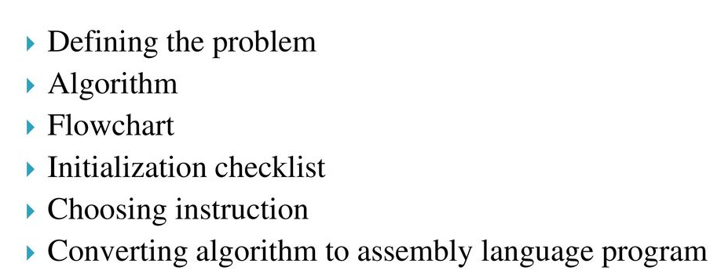
Program Development Steps*

Slide 4
Defining the Problem
The first step in writing a program is to think very carefully about the problem that you want the program to solve.
At this point you need not to write down a program but you must know what you would like to do.
Algorithm*
The formula or sequence of operations or tasks needed to perform by your program can be specified as a step in general English and is often called an Algorithm.

Slide 5
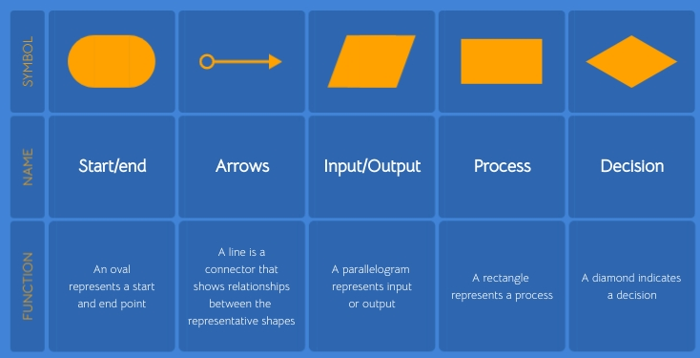
Flowchart*
The flowchart is a graphical representation of the program operation or task.
The specific operation or task is represented by graphical symbol such as circle, rectangle, diagonal, square and parallelogram etc. given below:

Slide 6
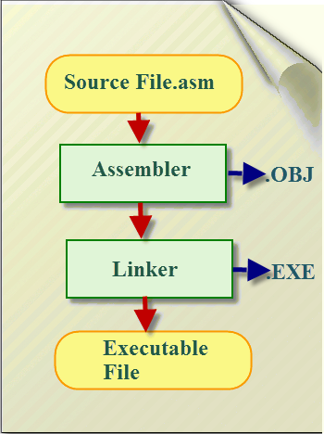
Initialization Checklist
Make the checklist of the entire variables, constants, all the registers, flags etc
Choosing Instructions
Assembly Language Program Development Tools
Editor
Debugger

Slide 7
Editor*
Function: An editor is a program which helps you to construct your assembly language program in the right format so that the assembler will translate it correctly to machine language.
So, you can type your program-using editor.
This form of your program is called a source program. The DOS based editor such as EDIT, WordStar, and Norton Editor etc. can be used to type your program.
Assembler*
Function: An assembler is a program that translates assembly language programs to the correct binary code for each instruction i.e. machine code and generates the file called as object file with extension .obj.
Some examples of assembler are TASM Borland's Turbo
Assembler and MASM Microsoft Macro Assembler etc.

Slide 8
Linker*
Function: A linker is a program, which combines, if requested, more than one separately assembled module into one executable program, such as two or more programs and also generates a .exe module and initializes it with special instructions to facilitate its subsequent loading the execution.
Some examples of linker are TLINK Borland's Turbo Linker and LINK Microsoft's Linker etc.
Debugger*
Function: Debugger is a program that allows the execution of a program in single step mode under the control of the user.
The process of locating and correcting errors using a debugger is known as debugging.
Some examples of debugger are DOS Debug command, Borland's turbo Debugger TD, Microsoft Debugger known as Code View CV etc.

Slide 9
Assembler Directives and Operator**
Directives
Assembly language programs support a number of reserved words i.e. key words that enable you to control the way in which a program assembles and lists.
These words are called assembler directives, act only during the assembly of the program and generate no machine executable code.
So, directives are the statement that gives direction to the assembler and also that are not translated into the machine code.
Directives are divided into various categories.------

Slide 10
Data Definition Directives
Data definition directives are used to define the program variables and allocate a specified amount of memory to them.
The data definition directives are DB, DW, DD, DQ, DT, STRUCT and RECORD.
DB: Define Byte*
The directive DB is used to define a byte type variable.
It can be used as a single or multiple byte variable.
General form
Name_Of_Variable DB Initialization_Value(s)
Examples
NUM DB ? ; Allocate One memory location
NAME DB 'VIJAY' ; Allocate Five memory locations
ARRAY DB 12, 25, 26, 55, 65 ; Allocate Five memory locations
LIST DB 100 DUP(0) ; Allocate Hundred memory locations

Slide 11
DW: Define Word*
The directive DW is used to define a word type i.c. 2-bytes variable.
It can be used to define single or multiple word variables.
General form
Name_Of _Variable DW Initialization_Value(s)
Examples
NUM DW ? ; Allocate two memory locations
NUM DW '78' ; Allocate two memory locations
TABLE DW 1, 2, 3, 4,5 ; Allocate ten memory locations
LIST DW 50 DUP(0); Allocate 100 memory locations

Slide 12
DD: Define Double Word*
The directive DD is used to define a double word type.i.e. 4 byte type variable.
General form
Name_Of _Variable DD Initialization_Value(s)
Examples
NUM DD ? ; Allocate four memory locations
TABLE DD 1, 2, 3, 4,5 ; Allocate 20 memory locations
LIST DD 10 DUP(0); Allocate 40 memory locations

Slide 13
EQU:Equate to
ORG:Originate
ALIGN: Alignment of memory address
EVEN: Align as even memory location
DUP:Duplicate memory location

Slide 14
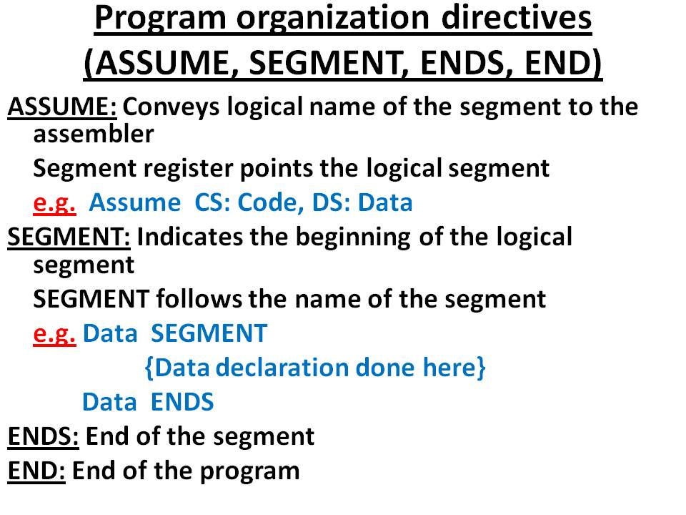
Program organization directives

Slide 15
1. The logic required for implementing a program can be expressed in terms of a) flowchart b) algorithm c) flowchart & algorithm. d) none of the mentioned
Explanation: The logic required for implementing a program must be visualized clearly which is possible by flowchart and algorithm.
1. The assembler directives which are the hints using some predefined alphabetical strings are given to a) processor b) memory c) assembler. d) processor & assembler
Explanation: These directives help the assembler to correctly understand the assembly language programs to prepare the codes.

Slide 16
1. The disadvantage of machine level programming is a) time consuming b) chances of error are more c) debugging is difficult d) all of the mentioned.
2. The coded object modules of the program to be assembled are present in a) .ASM file b) .OBJ file. c) .EXE file d) .OBJECT file
3. The advantages of assembly level programming are a) flexibility of programming is more b) chances of error are less c) debugging is easy d) all of the mentioned.

Slide 17
4. The extension that is essential for every assembly level program is a) .ASP b) .ALP c) .ASM. d) .PGM
5. The directory that is under work must have the files that are related to a) Norton’s editor b) Assembler c) Linker d) All of the mentioned
Explanation: Before starting the process of entering a small program on PC, ensure that all the files namely Norton’s editor, assembler, linker and debugger are available in the same directory in which work is been done.

Slide 18
2. The directive used to inform the assembler, the names of the logical segments to be assumed for different segments used in the program is a) ASSUME b) SEGMENT c) SHORT d) DB
Answer: a Explanation: In ALP, each segment is given a name by using the directive ASSUME SYNTAX: ASSUME segment:segment_name Eg: ASSUME CS:Code here CS is the Code segment and code is the name assumed to the segment.

Slide 19
Match the following
4. The directive that marks the end of an assembly language program is a) ENDS b) END c) ENDS & END d) None of the mentioned Explanation: The directive END is used to denote the completion of the program.
a) DB | 1) used to direct the assembler to reserve only 10-bytes
b) DT | 2) used to direct the assembler to reserve only 4 bytes
c) DW | 3) used to direct the assembler to reserve byte or bytes
d) DD | 4) used to direct the assembler to reserve words

Slide 20
5. The directive that marks the end of a logical segment is a) ENDS b) END c) ENDS & END d) None of the mentioned
Answer: a Explanation: The directive ENDS is used to end a segment where as the directive END is used to end the program.
6. The directive that updates the location counter to the next even address while executing a series of instructions is a) EVN b) EVEN c) EVNE d) EQU
Answer: b Explanation: The directive updates location counter to next even address if the current location counter contents are not even.

Slide 21
7. The directive that directs the assembler to start the memory allotment for a particular segment/block/code from the declared address is a) OFFSET b) LABEL c) ORG d) GROUP
Answer: c Explanation: If an ORG is written then the assembler initiates the location counter to keep the track of allotted address for the module as mentioned in the directive. If the directive is not present, then the location counter is initialized to 0000H.
8. The directive that marks the starting of the logical segment is a) SEG b) SEGMENT c) SEG & SEGMENT d) PROCView Answer
Answer: b Explanation: The directive SEGMENT indicates the beginning of the segment.

